Slide 1
Hospital Readmission of Diabetic Patients
Eunice brandares

Slide 2


AGENDA
EXECUTIVE SUMMARY
METHODOLOGY
MODELLING
RESULTS

Slide 3

HOSPITAL READMISSION
Hospital Readmission is a healthcare concern in the USA; around 14% of discharged patients are getting readmitted within 30 days. Diabetes is the third leading cause of readmission. Because of this, many hospitals such as the Great River Medical Center want to improve hospital readmissions of their diabetic patients.

Slide 4
objective
To give insights about the hospital’s diabetic patients and make a predictive model to identify patients that are most likely to be readmitted.

Slide 5




Key Insights
inpatient visits
How often a patient is admitted to the hospital and stays at least one night.
Around 1/3 of the hospitalization in 2018 involved patients with a diabetes diagnosis.
MULTIPLE diagnosis
The total number of diagnosis a patient has
Most people with type-2 diabetes have other underlying conditions (such as hypertension, CHD, CKD) that can impact management of their diabetes.

Slide 6
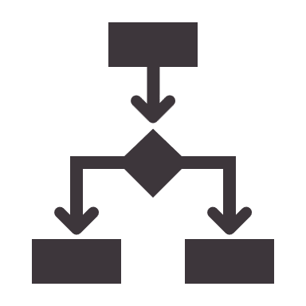


methodology
sample
explore
modify
Data exploration
Checking the null values and data types
Checking relationship between variables
Excluding patient records of the dead (expired)
Variable selection: Excluding variables with at least 30% missing values
Imputing missing values
Partitioning the dataset into training and validation portions (80-20)

Slide 7



methodology
model
assess
implement
Base Logit Regression Model
10-Fold Cross-Validation Logit Regression Model
Decision Tree
Random Forest
Various evaluation methods were used for assessment
Accuracy
Sensitivity
Specificity
Precision
F1-Score
Cohen’s Kappa
Area under ROC curve
The best model is the Random Forest with an average accuracy of 76% (train and validation)
The Random Forest model is used to predict if a patient in the test data is going to be readmitted within 30 days

Slide 8
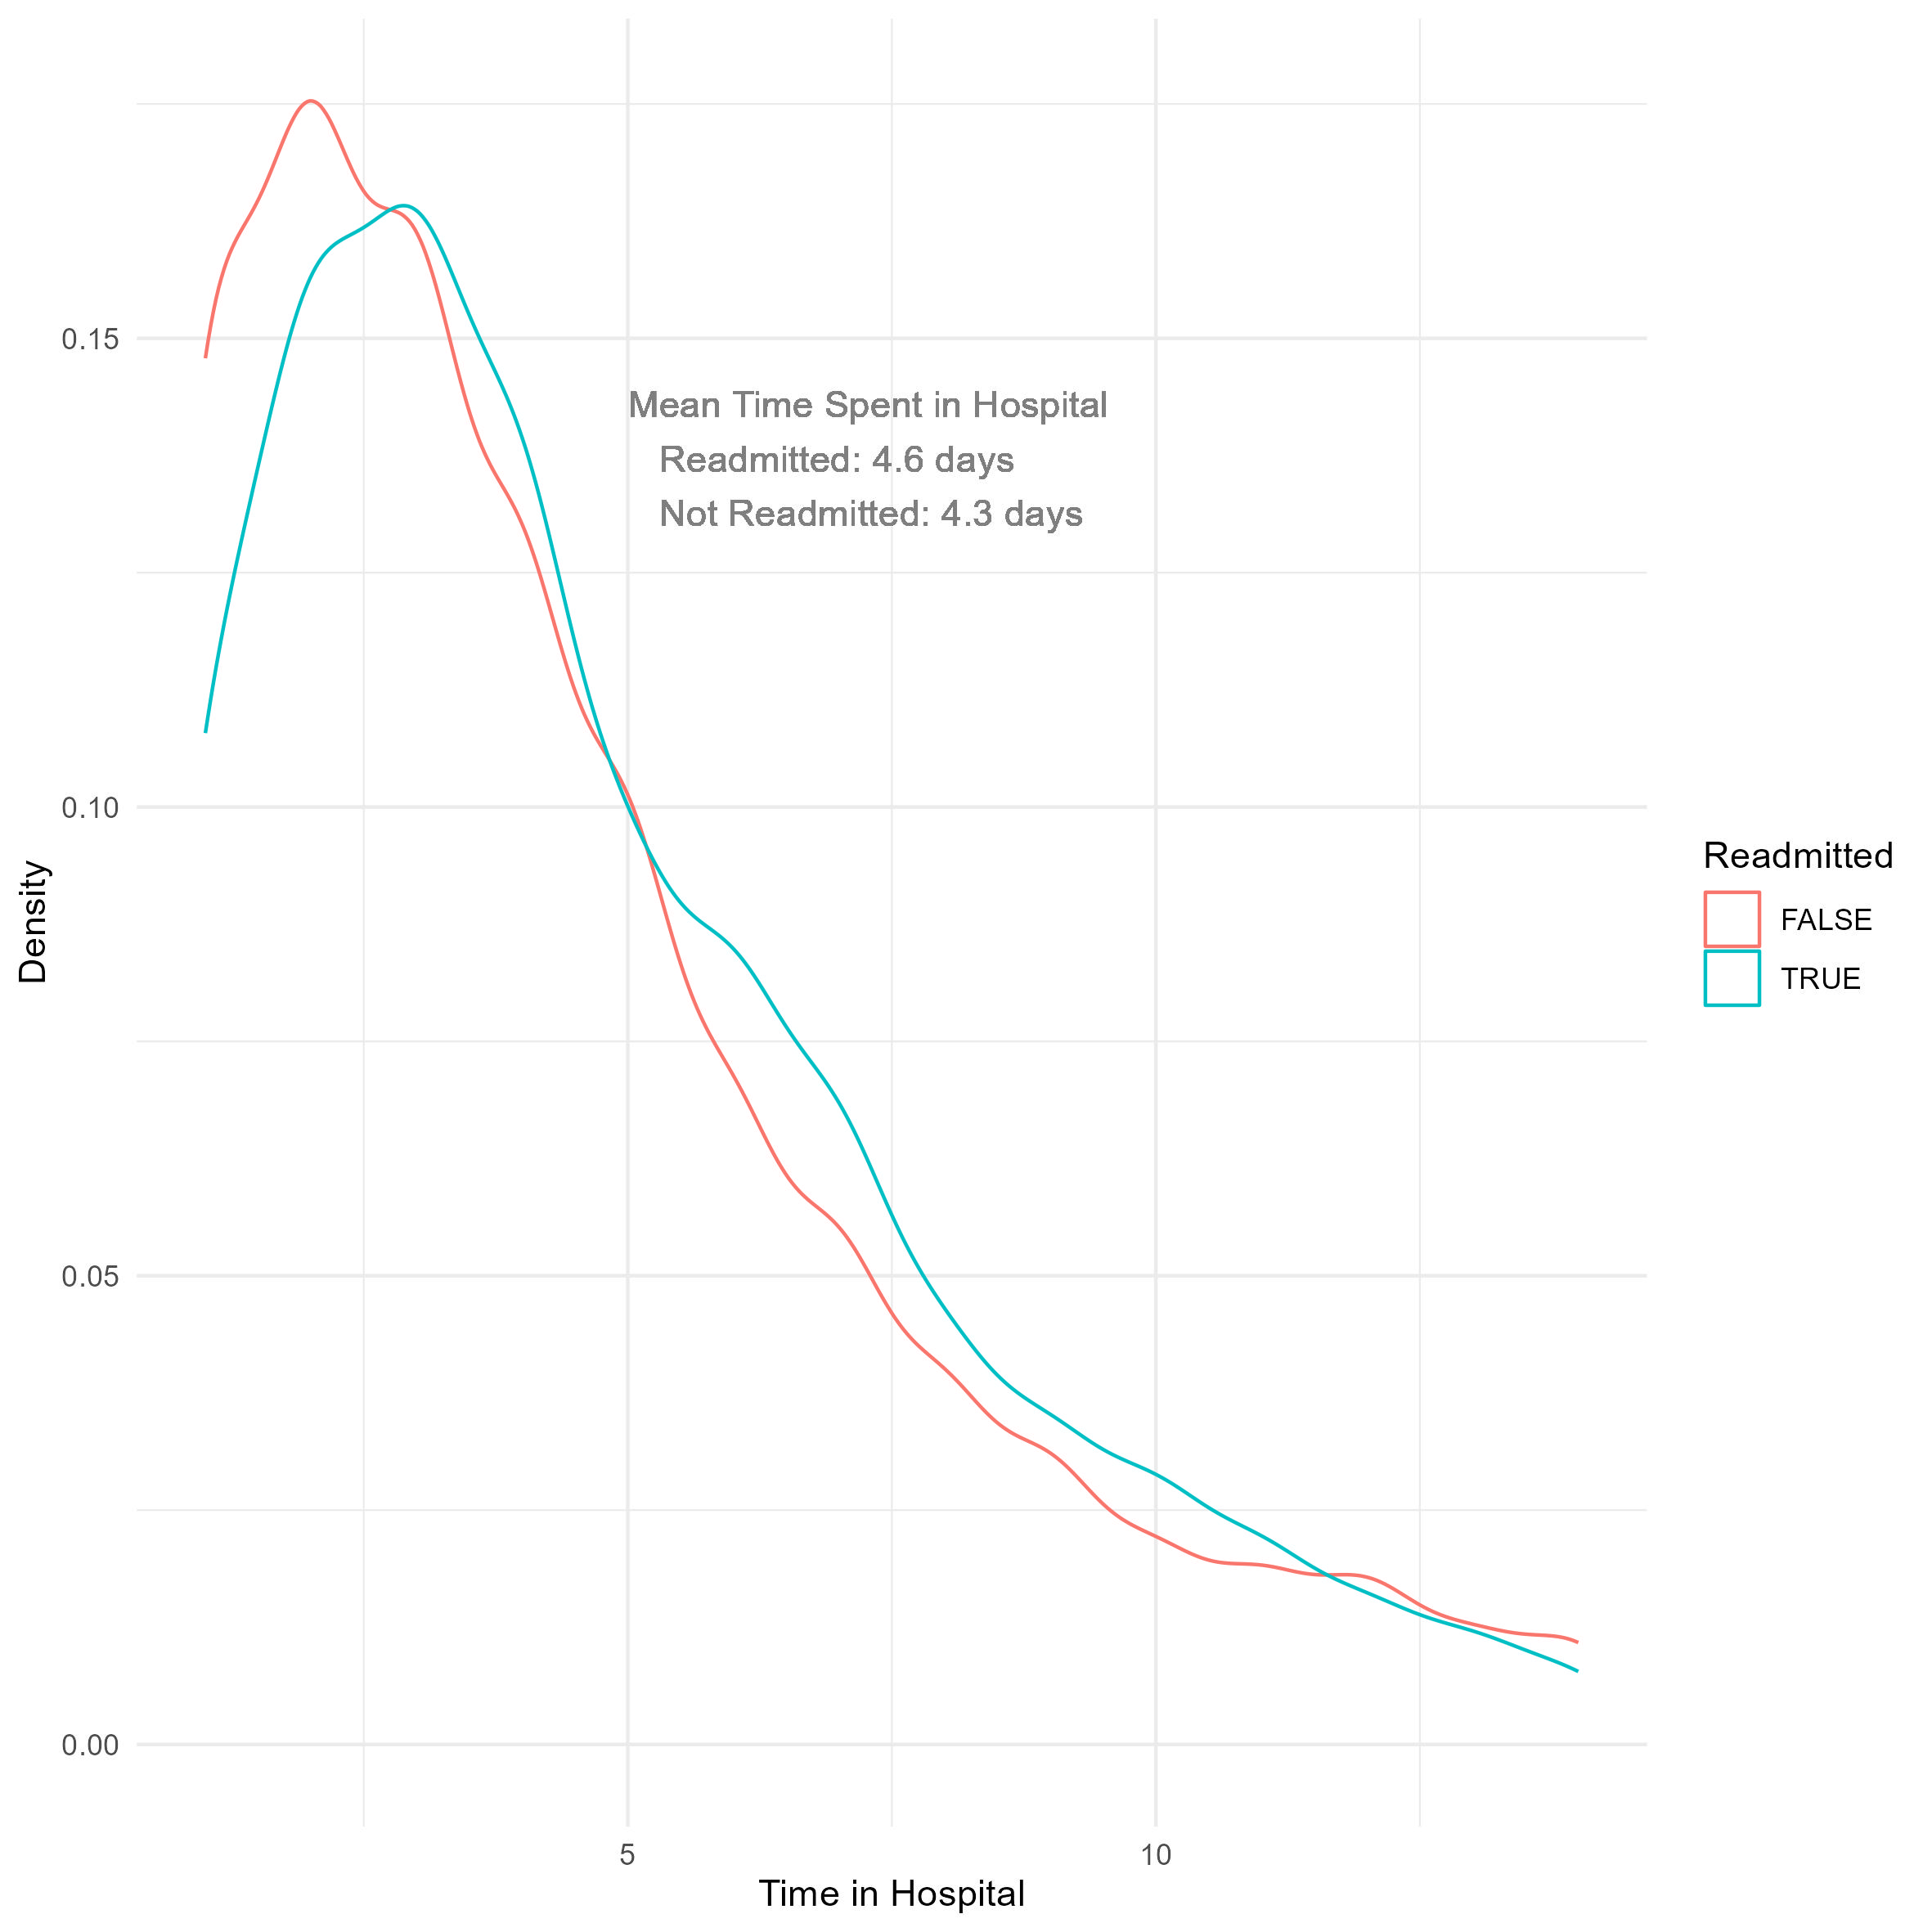
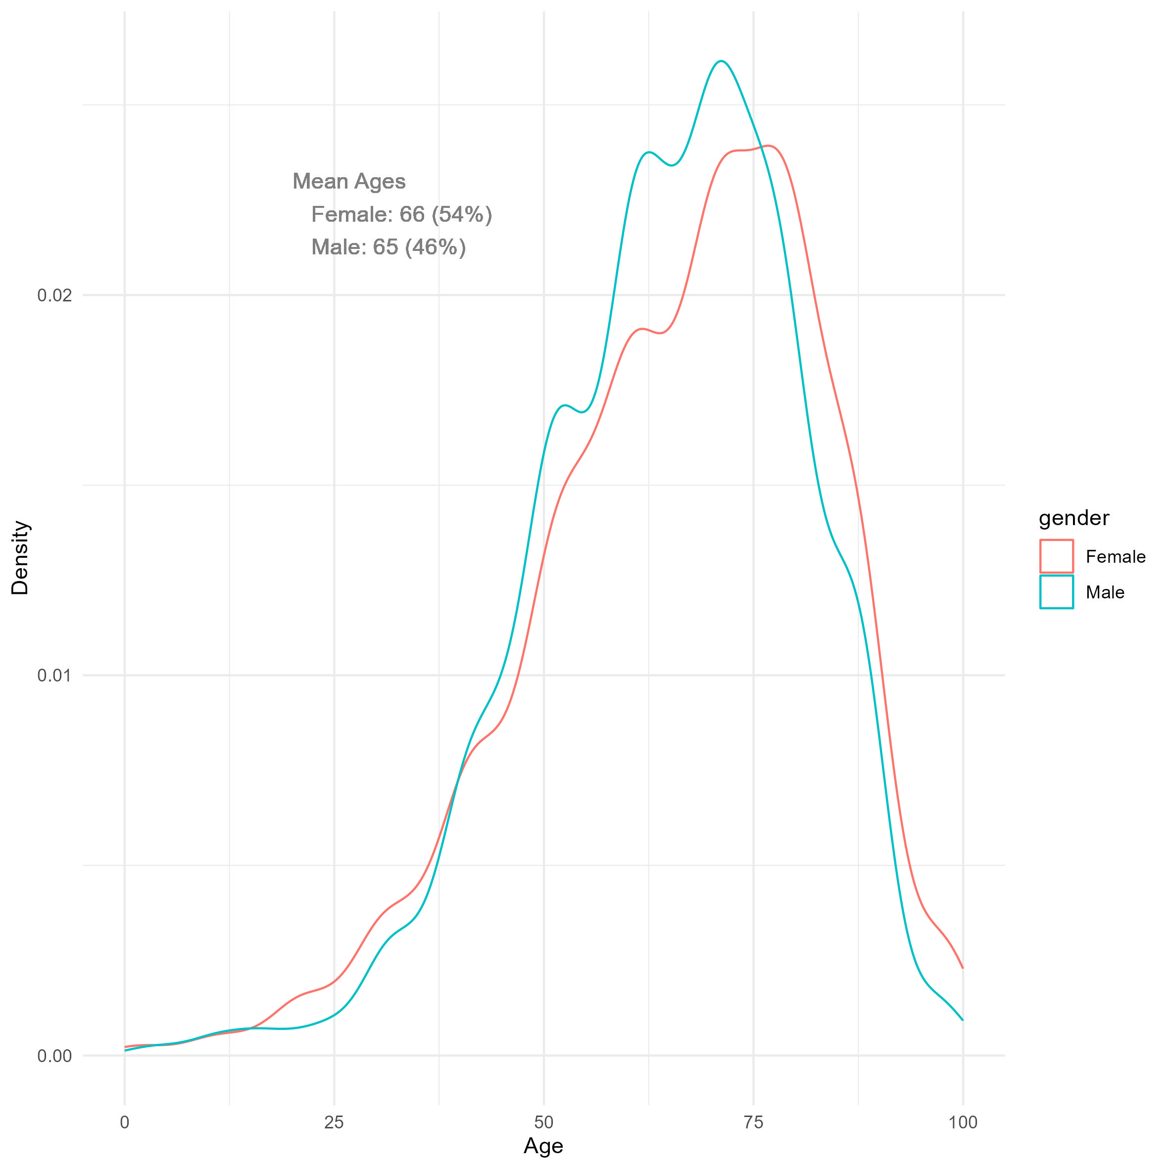
EXPLORING THE DATA

Slide 9
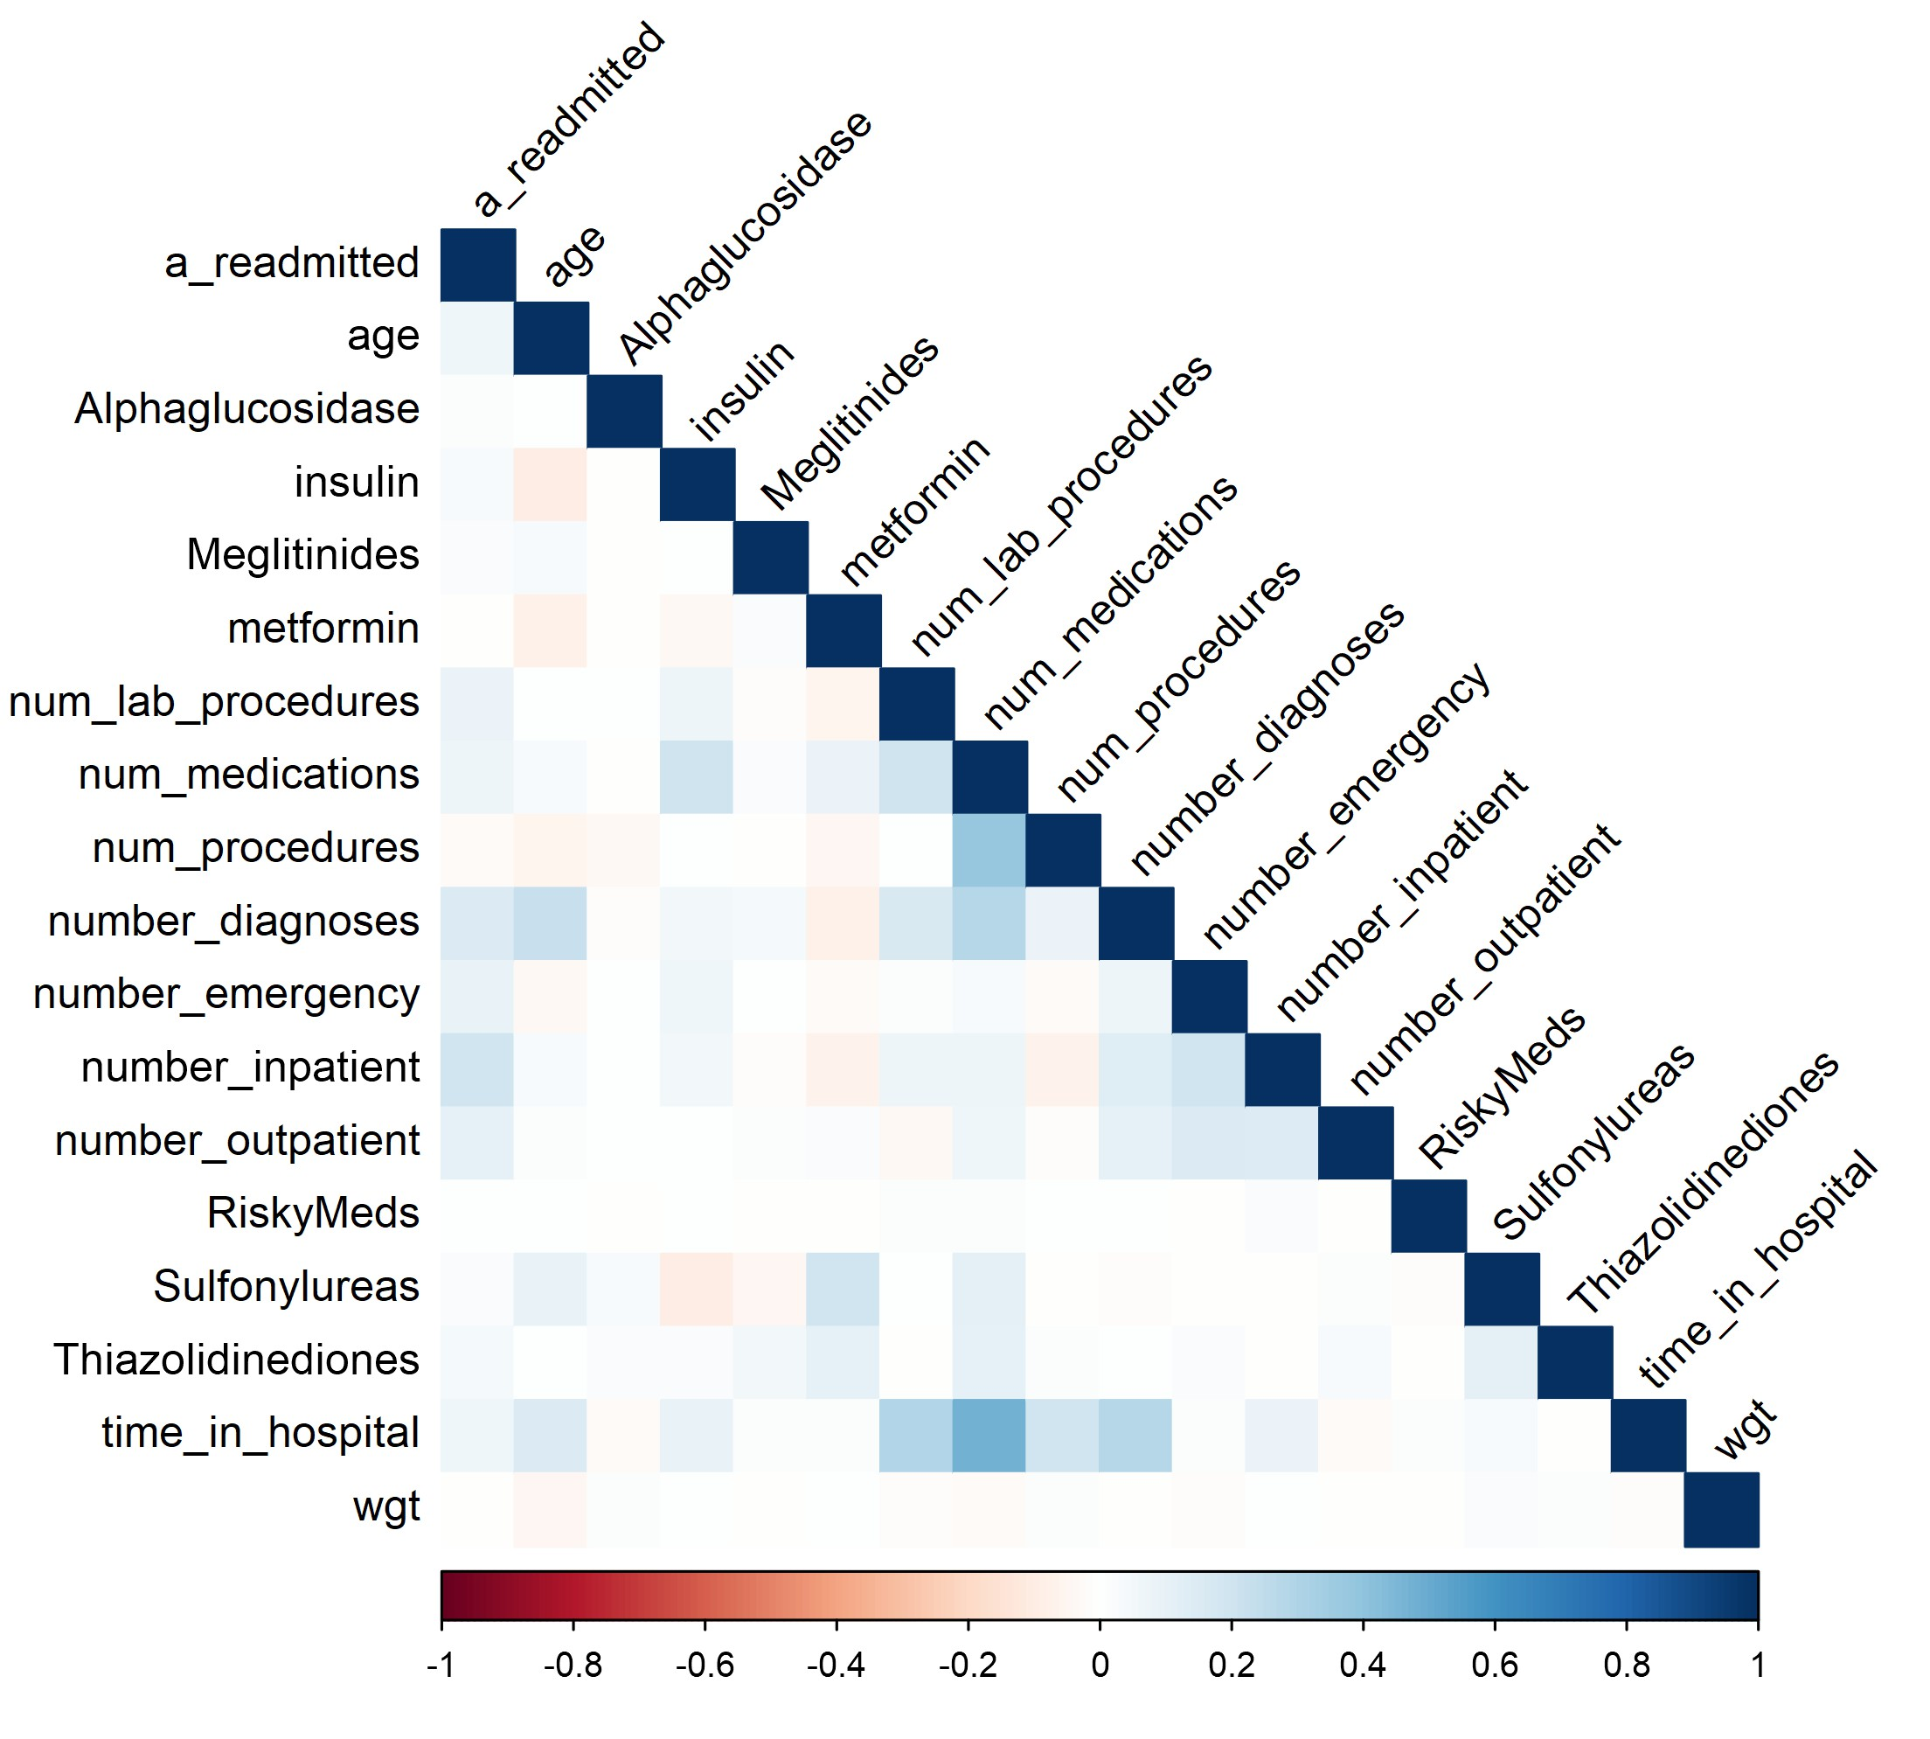
C O R R E L A T I O N

Slide 10
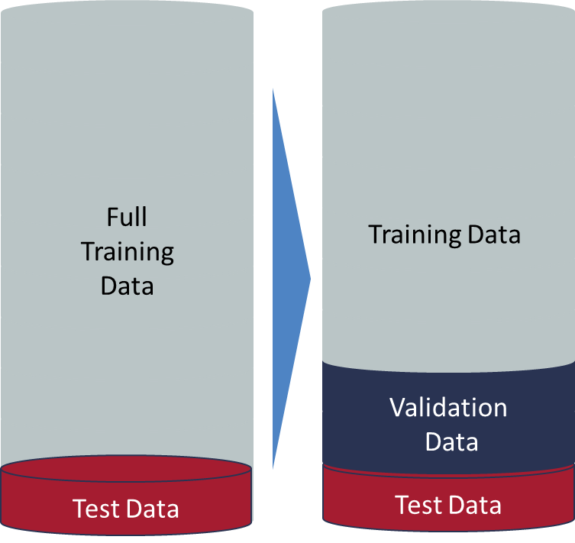
MODEL ASSESSMENT METHOD
The data has already been divided into training dataset (including target variable) and test dataset (without target variable)
Divide training data into main training portion & validation portion
Tune multiple models using the training data; Compare models using evaluation methods (i.e. accuracy)
Implement tuned models using the validation portion; Compare models using evaluation methods (i.e. accuracy) and compare with training evaluation to see stability
Predicted target variable in the test dataset using the best model (accurate and stable)

Slide 11
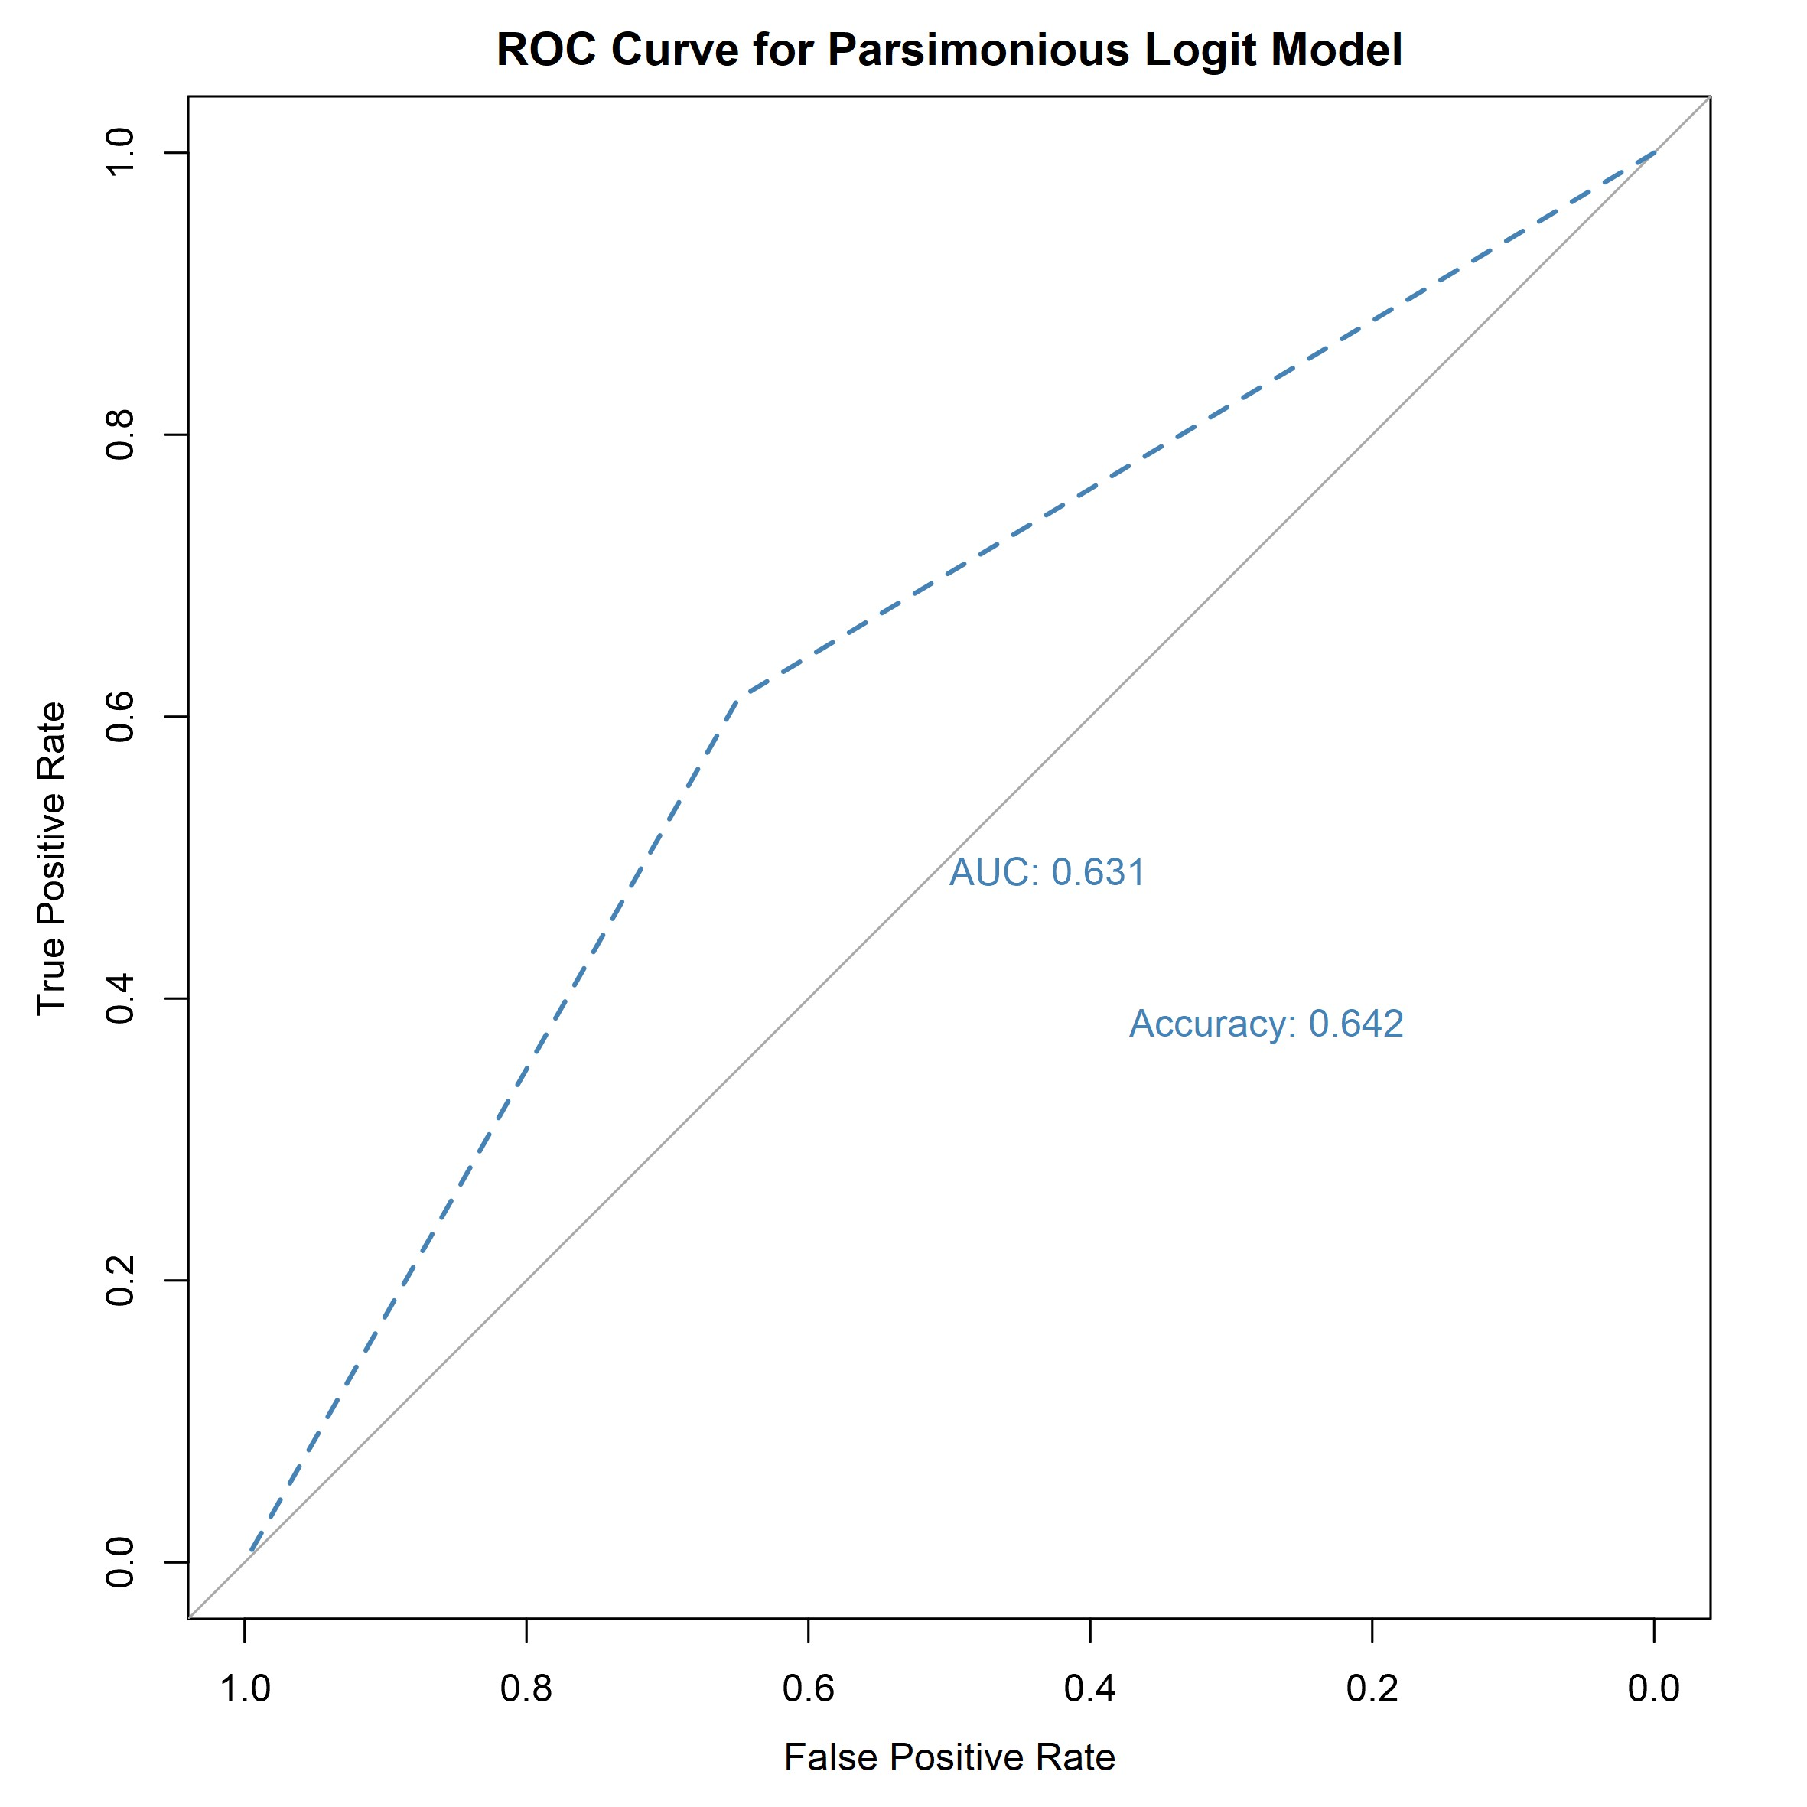
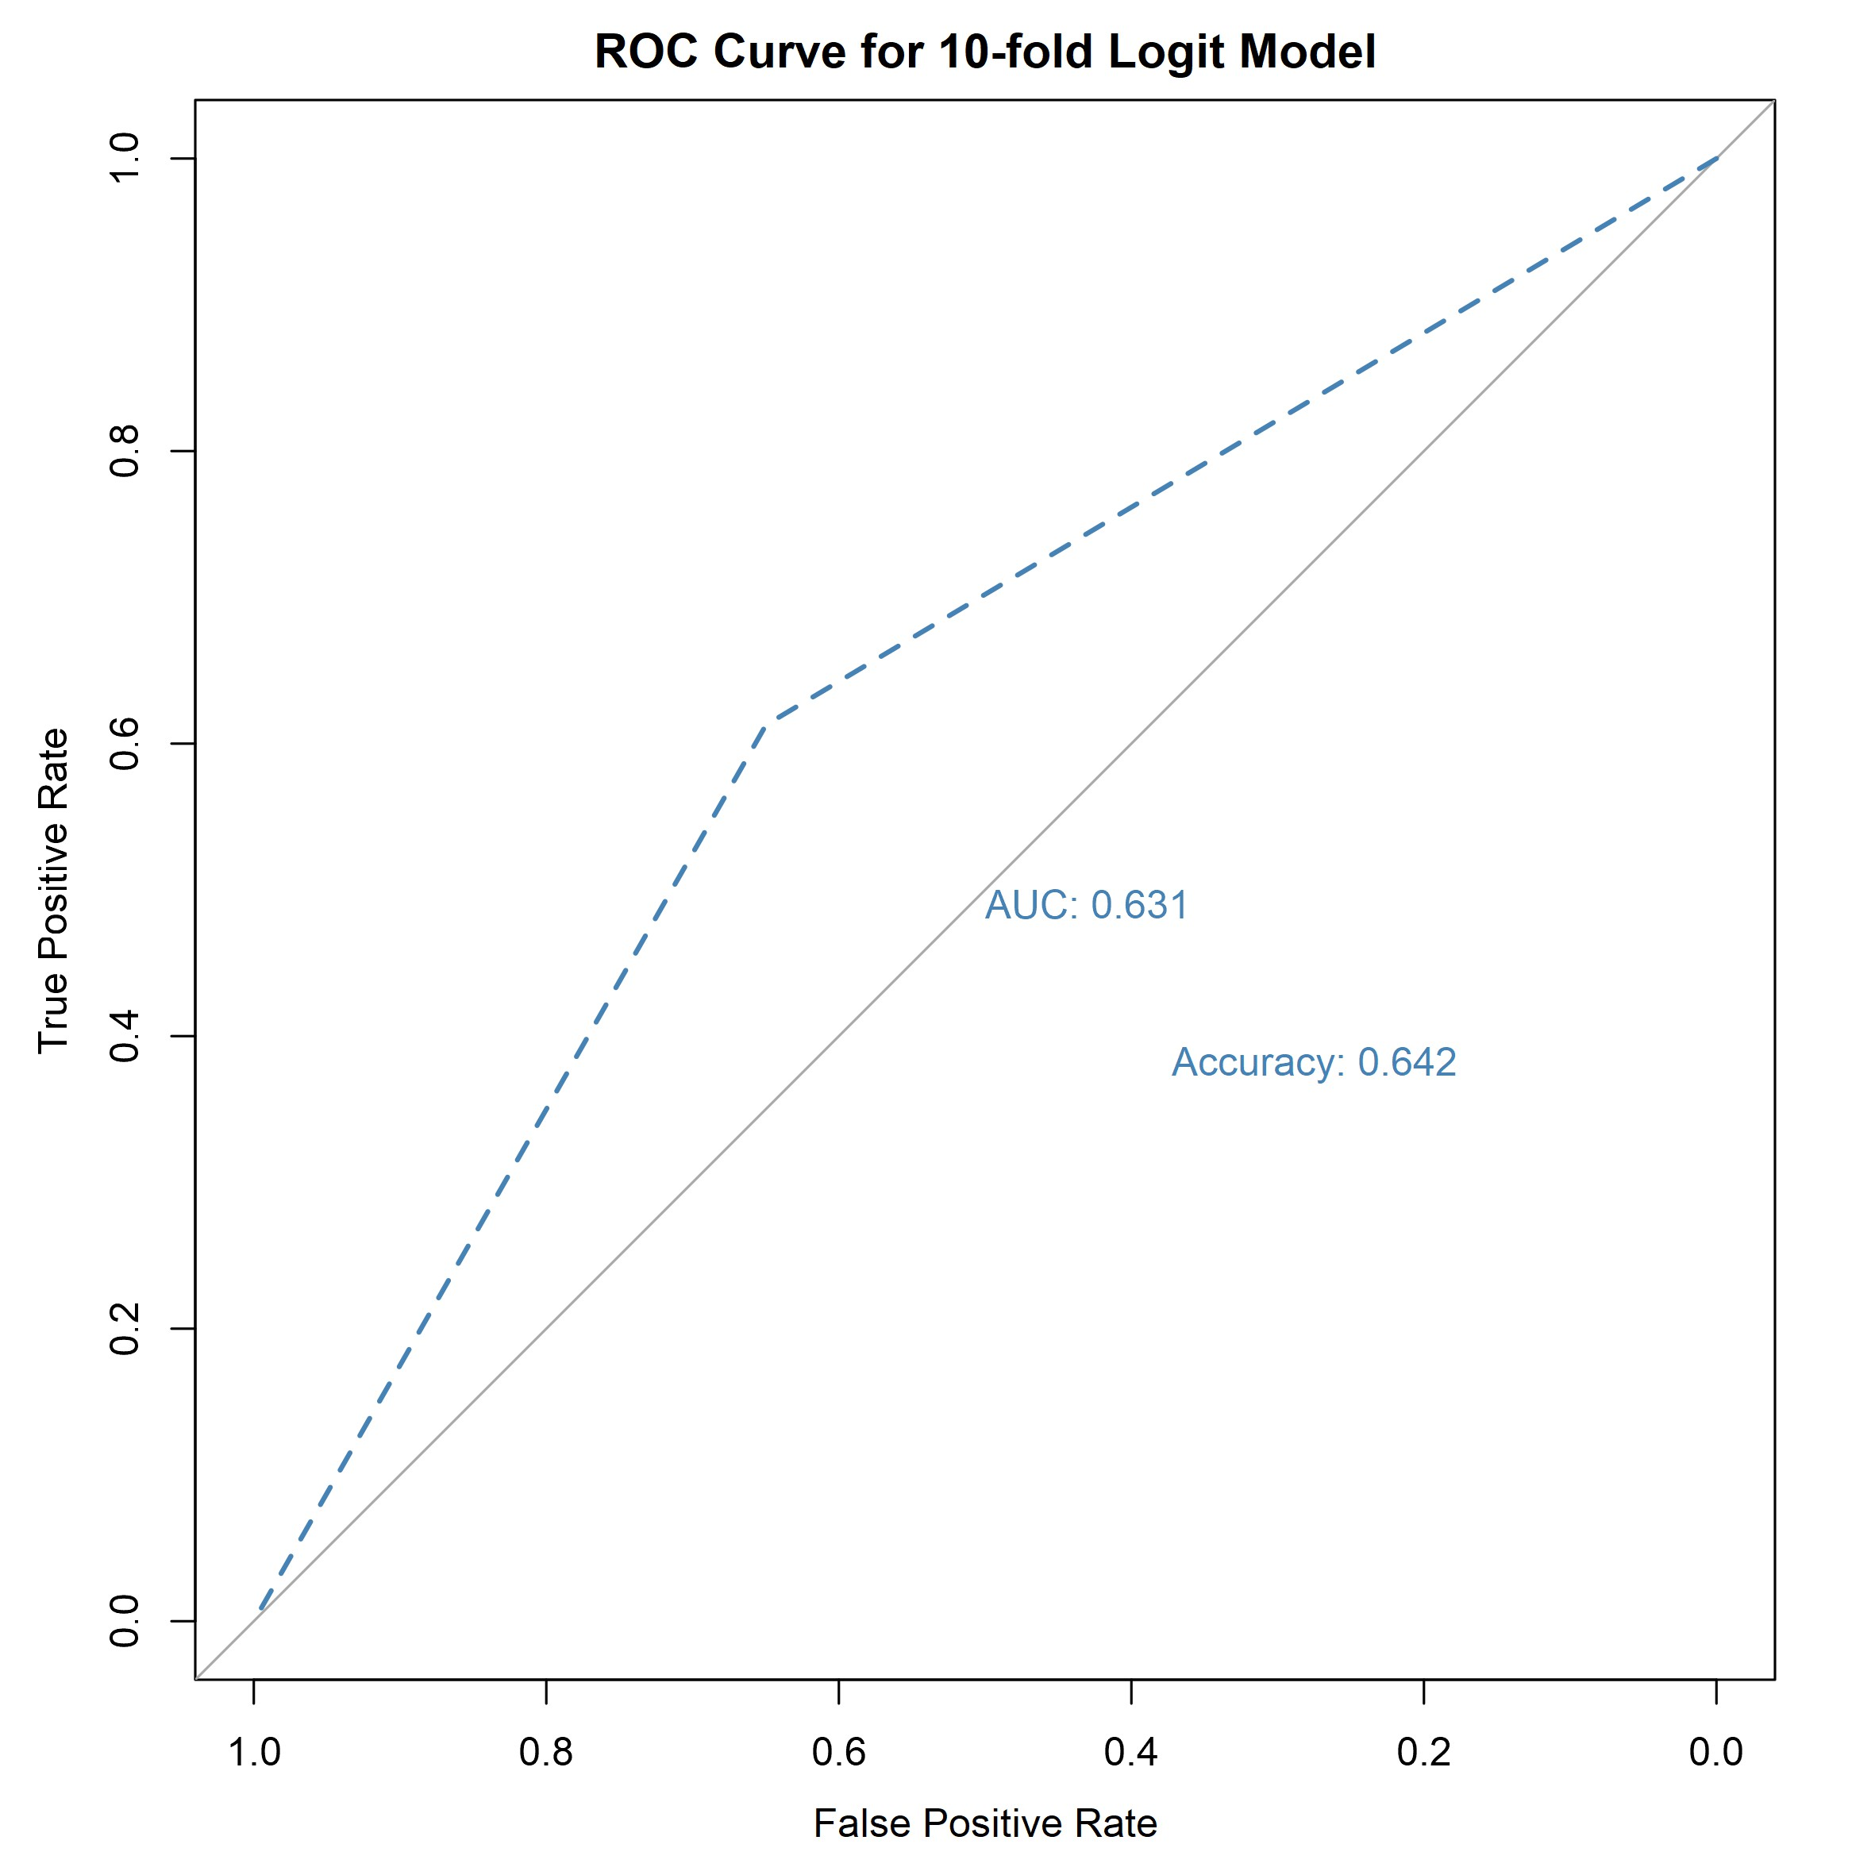
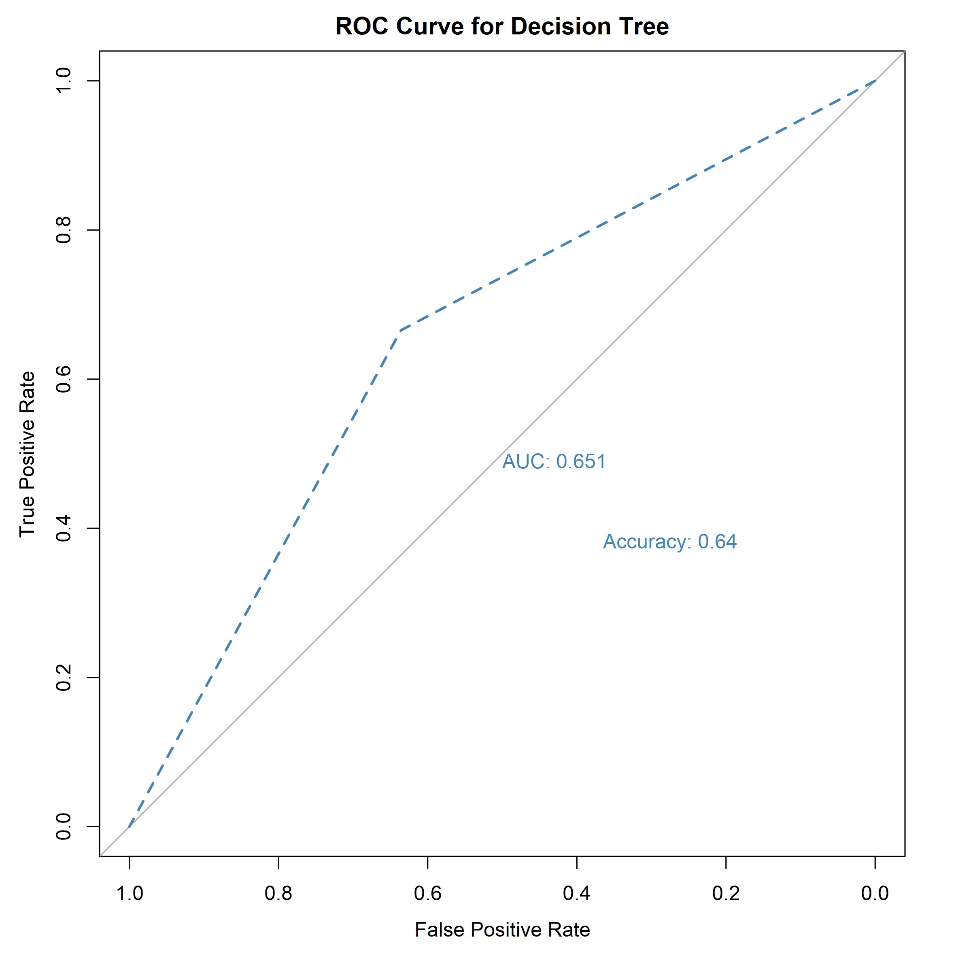
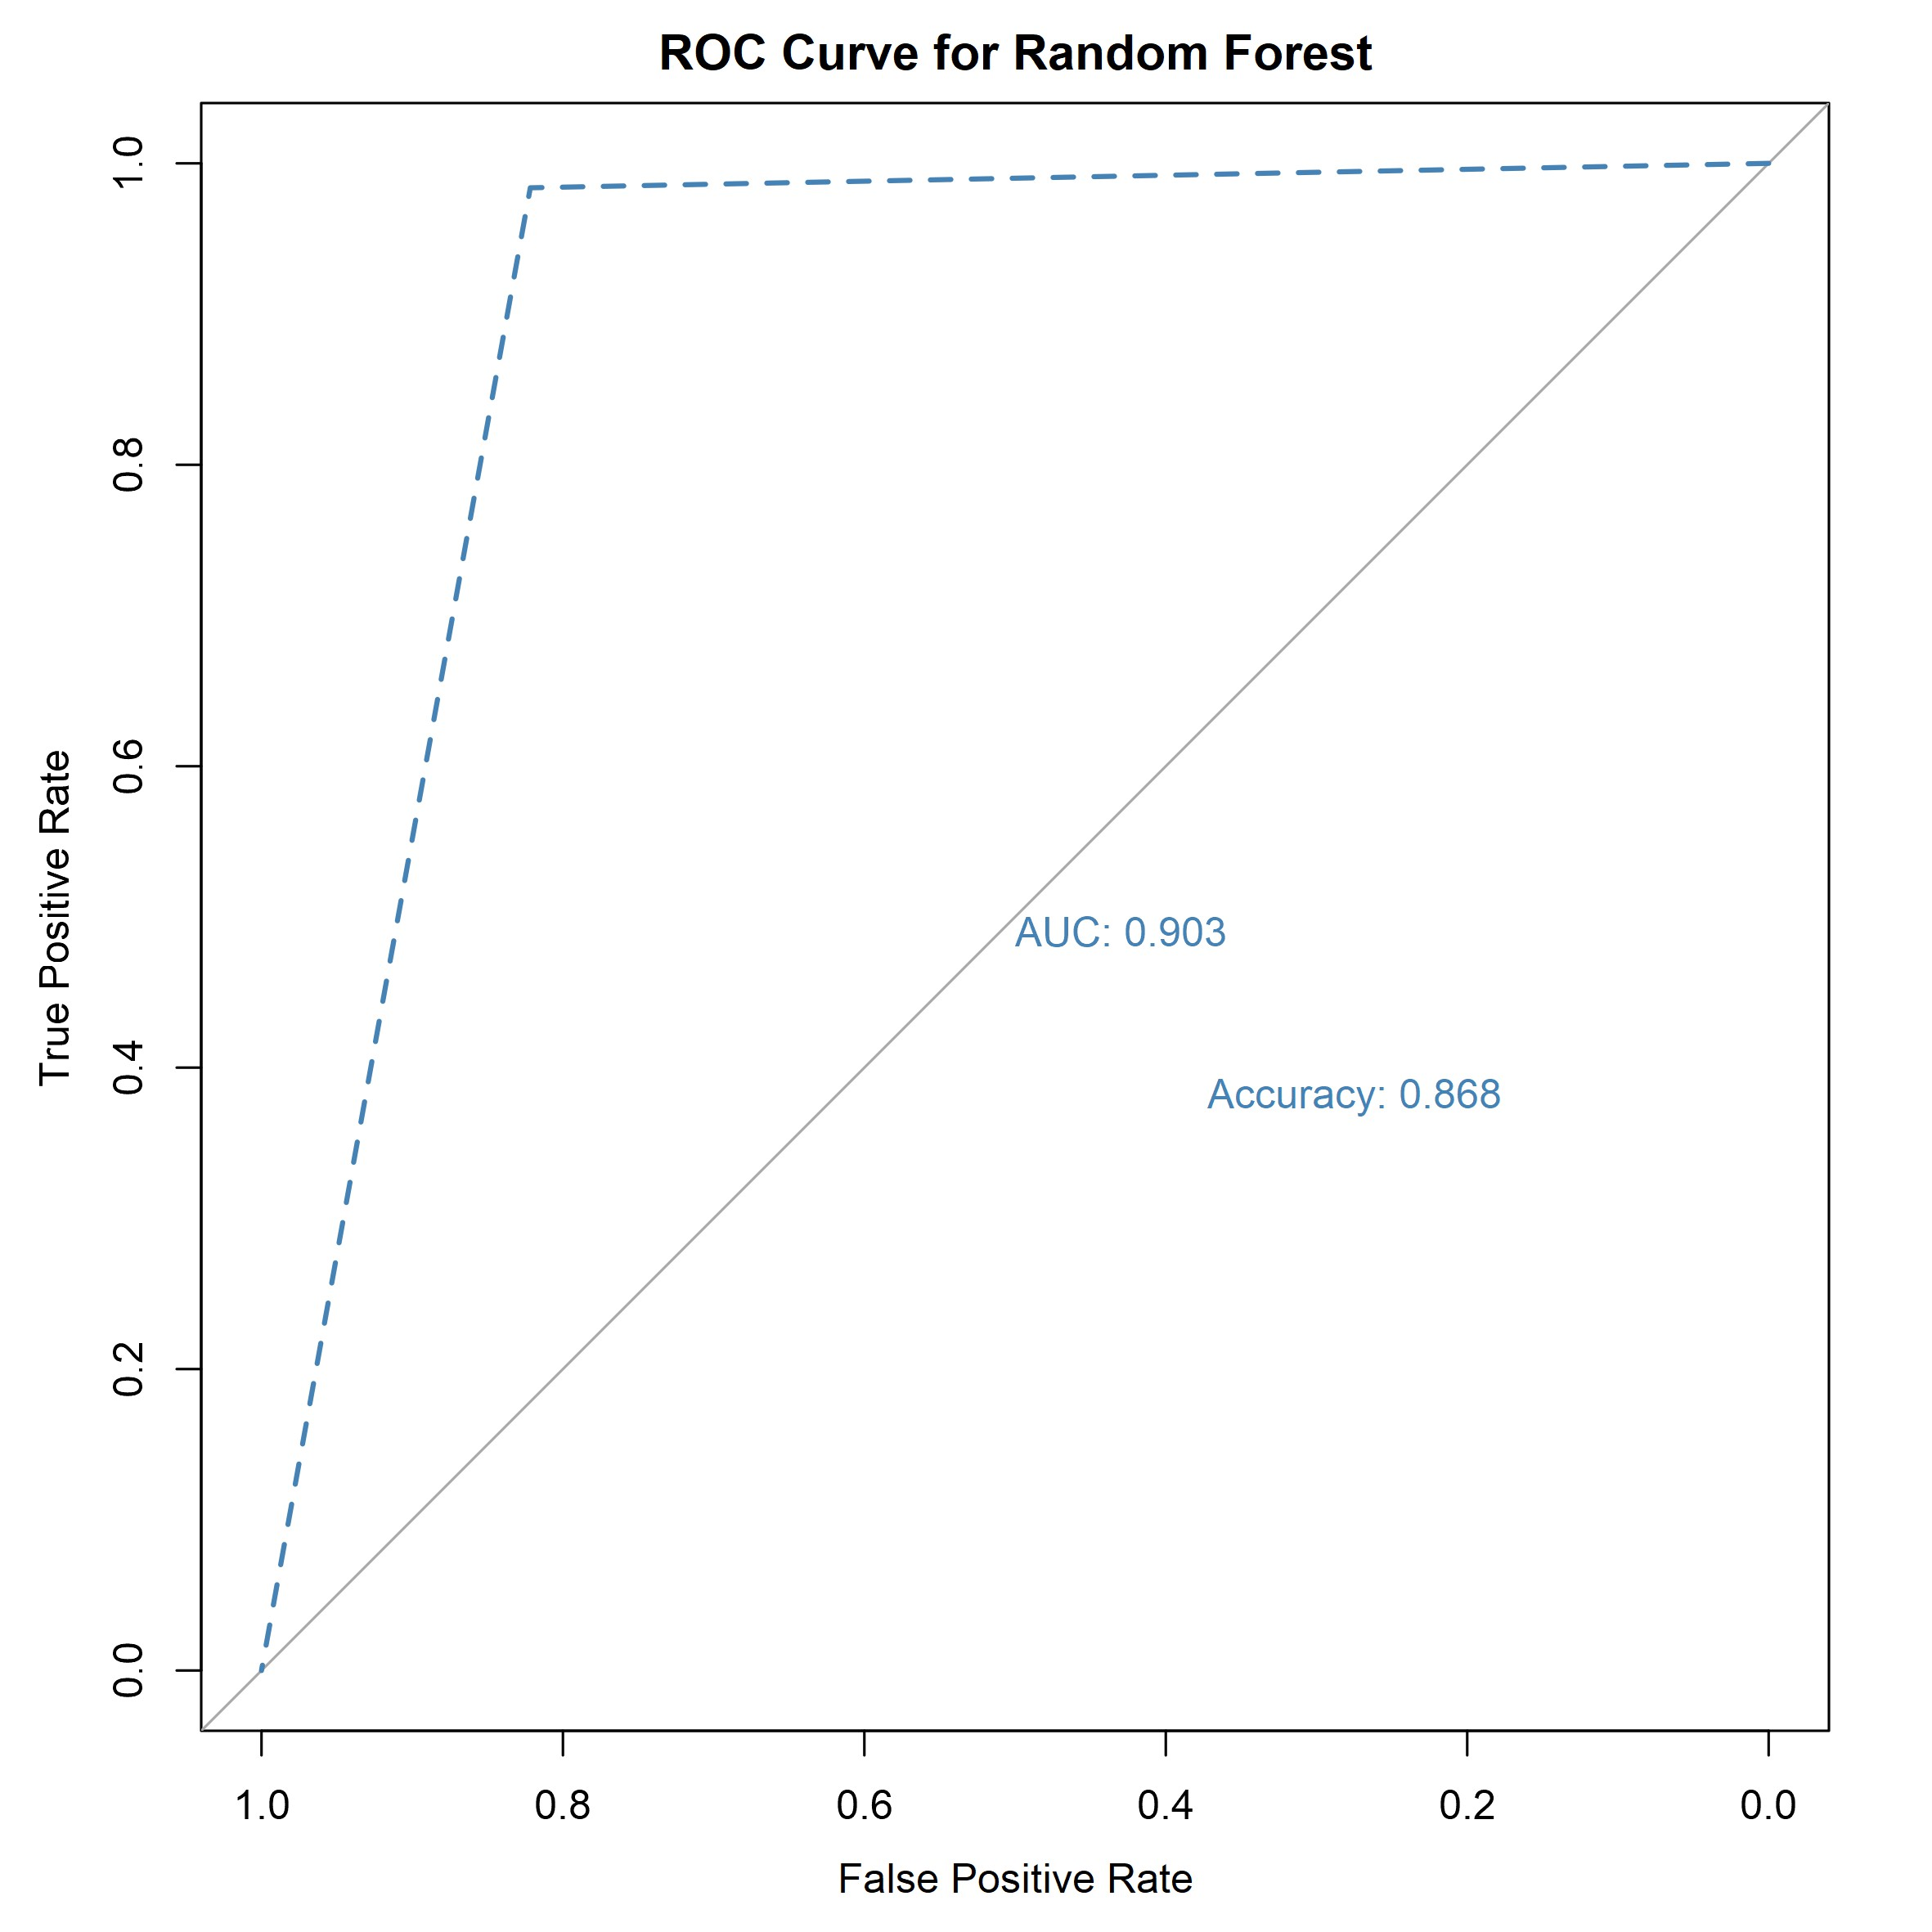
V A R I O U S M O D E L
The ROC curve is a graphical representation of how well a binary classification model distinguishes positive and negative classes.
The larger the area under the curve, the better the model is at correctly identifying positive cases while minimizing false negatives.

Slide 12
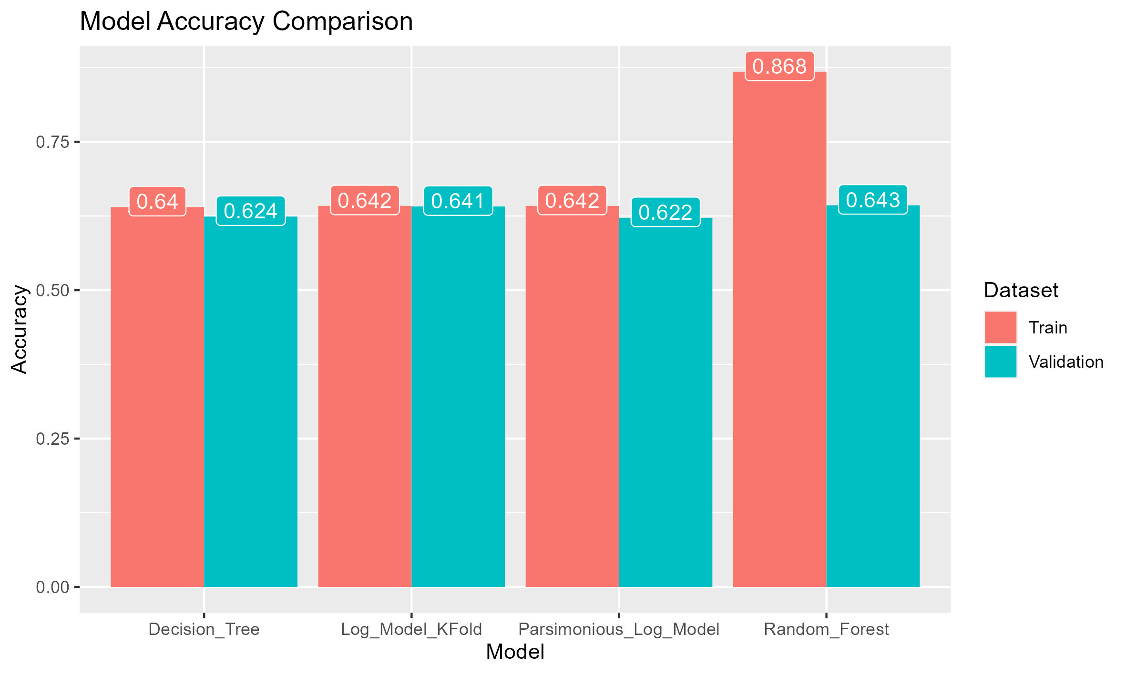
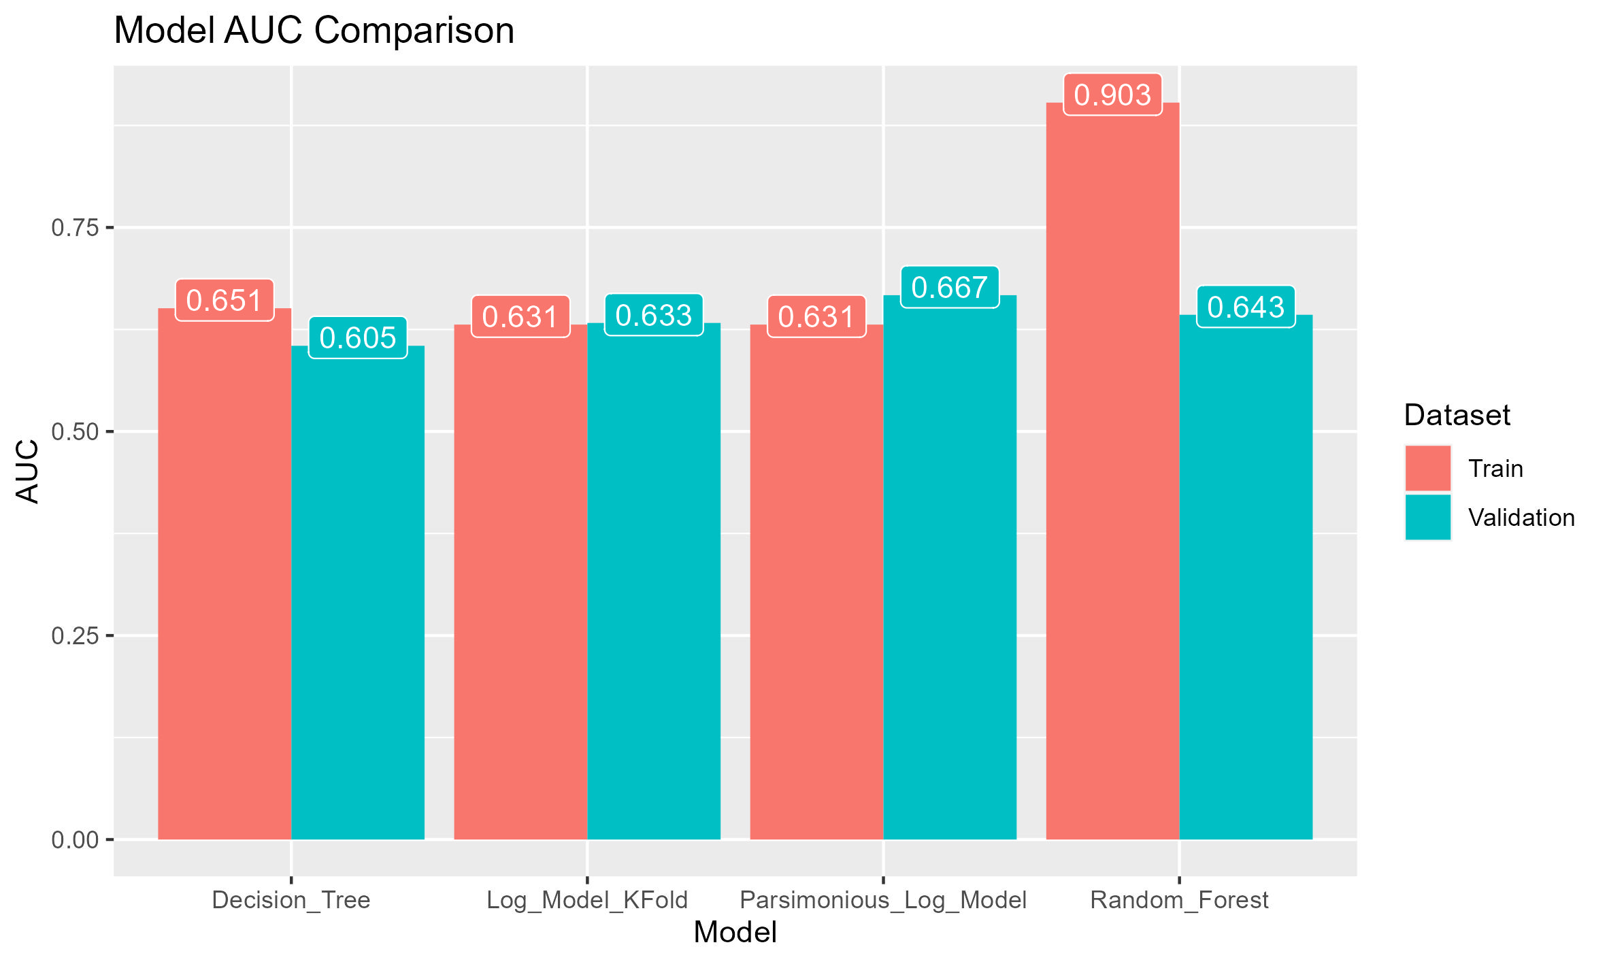
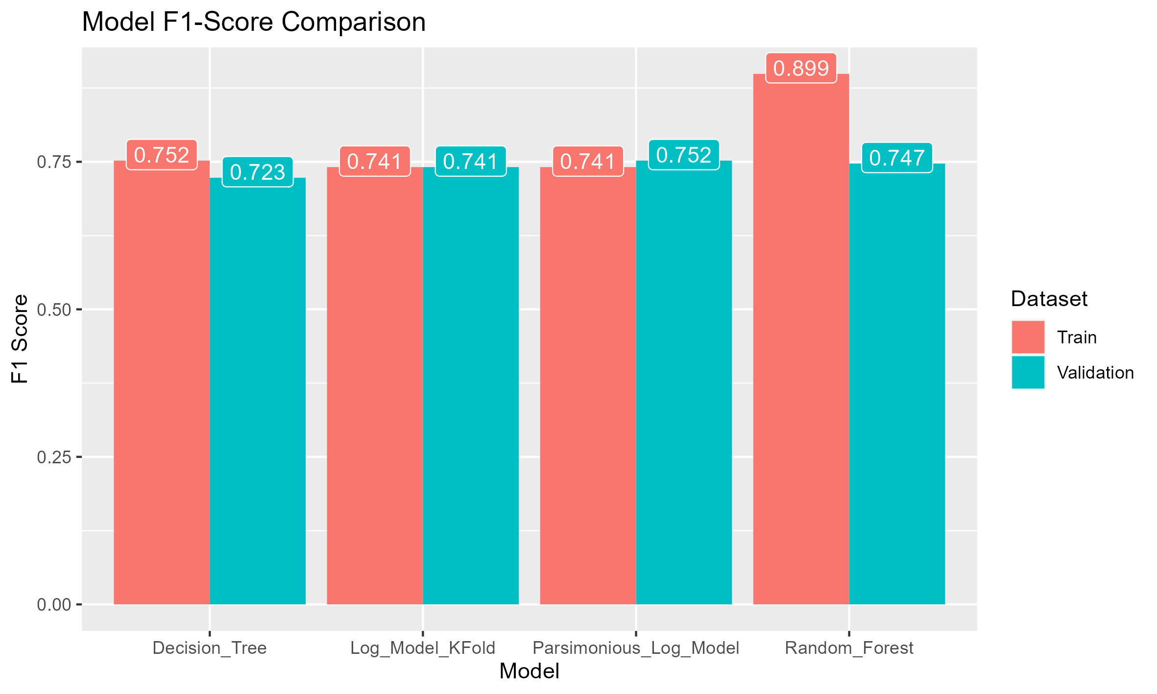
A S S E S S M E N T
Accuracy is the percentage of correct predictions, which indicates how often the model is correct.
F1-Score looks into the correctly classified positive instances and the proportion of true positives, which indicates how balanced the model is in making correct predictions for both positive and negative cases.

Slide 13
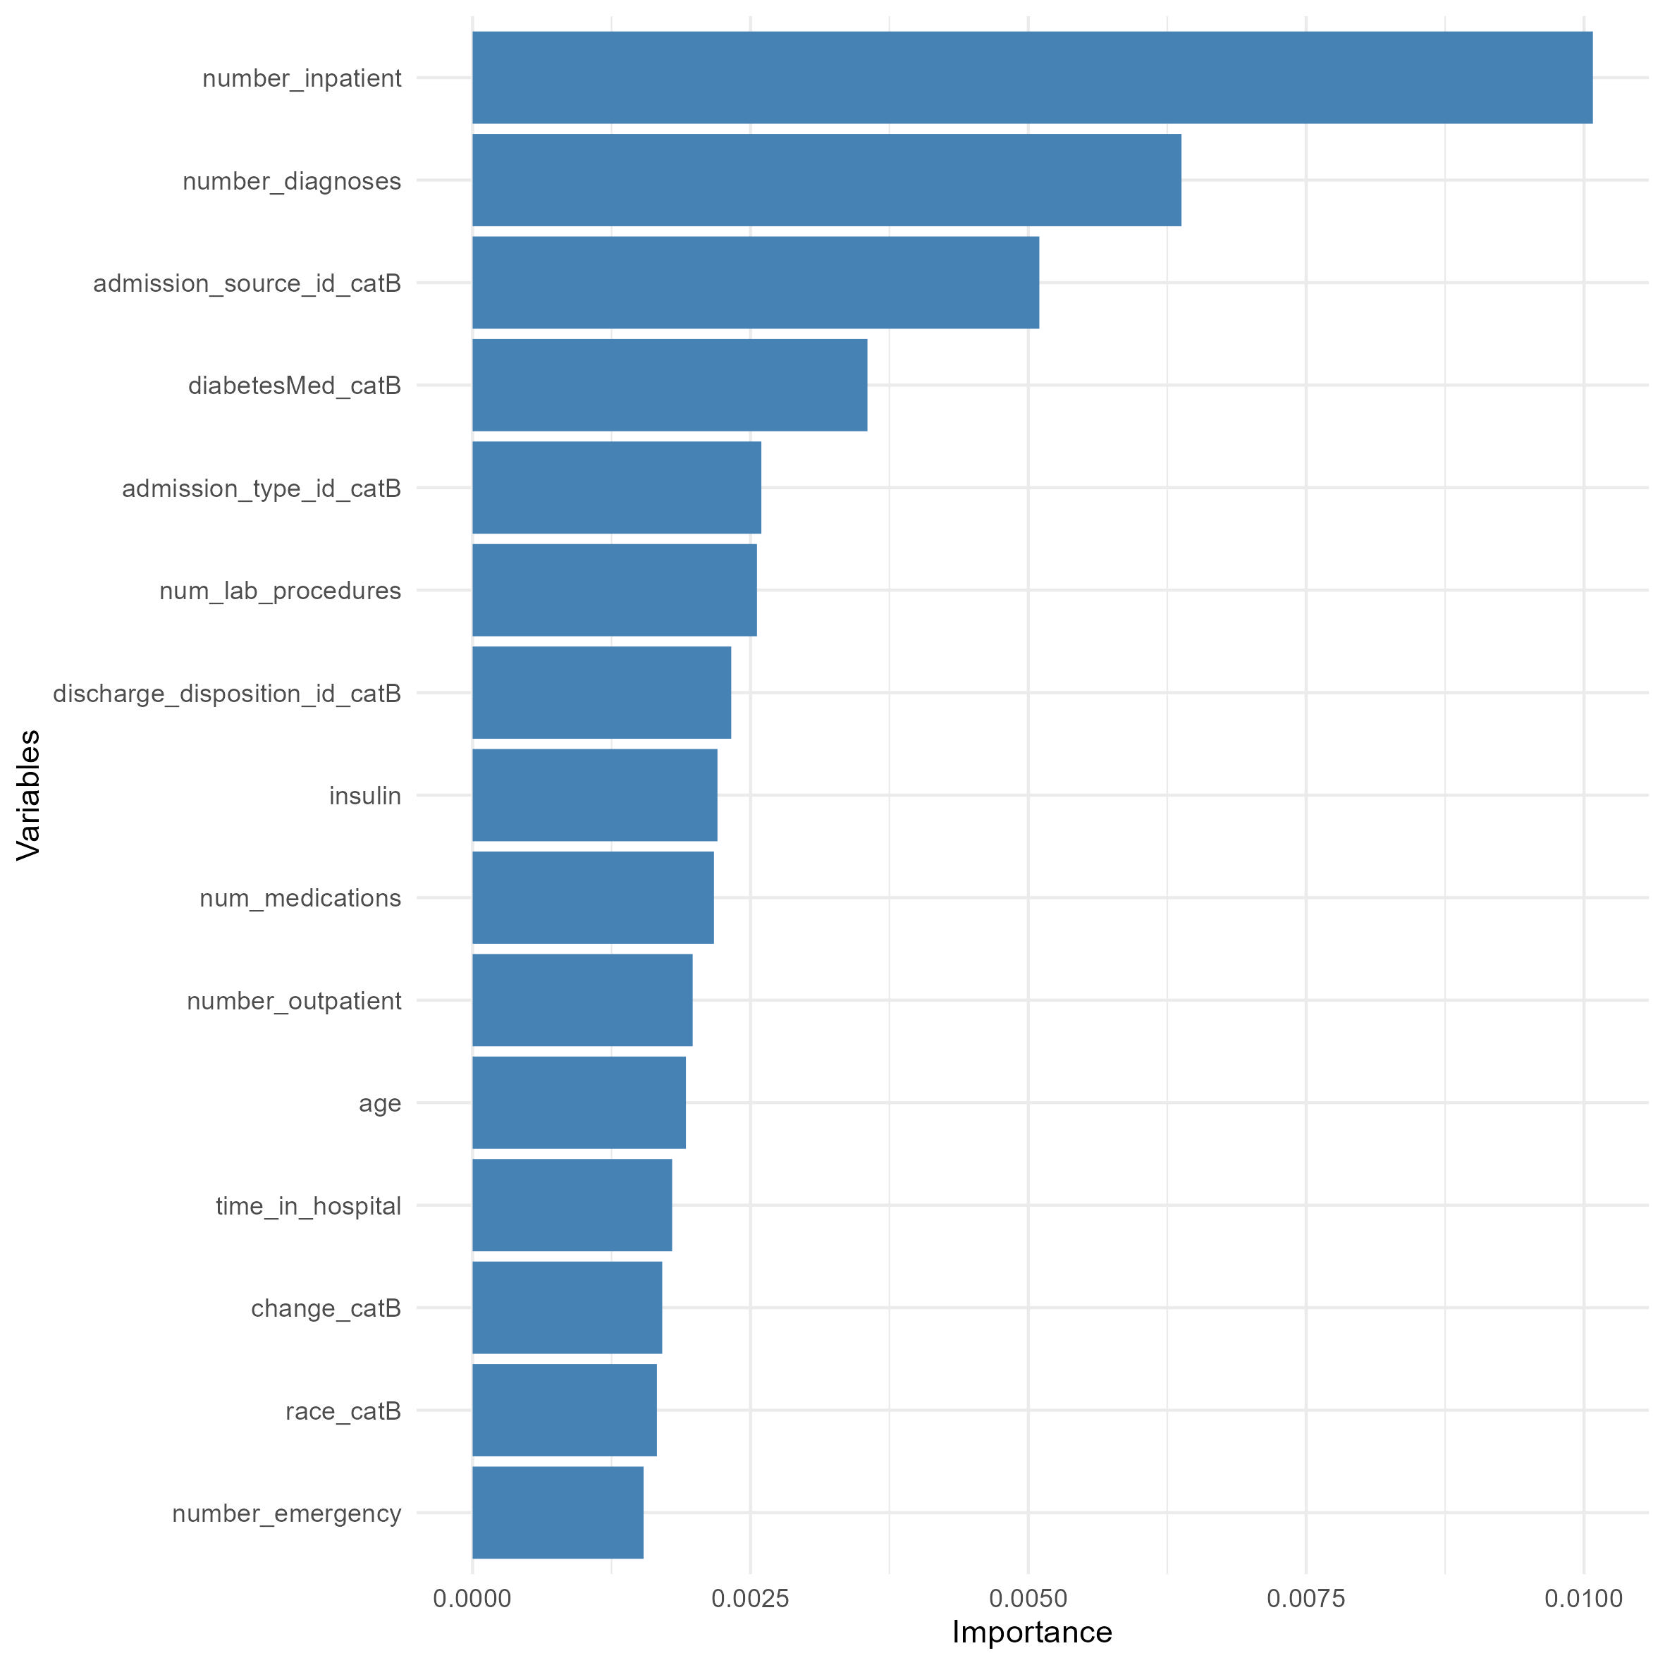
Important variables

Slide 14

results
The random forest model was seen to be the best model in terms of accuracy for both training and validation portions.
The top two predictive variables in the model: number_inpatient and number_diagnoses.
The probability of being readmitted in the hospital rely more on how sickly a patient is, than any other factor.

Slide 15
"Prediction is very difficult, especially about the future."
“
”
Niels Bohr

Slide 16
THANK YOU
Eunice Brandares
ebrandares@student.hult.edu
https://www.linkedin.com/in/eunice-brandares/

